Slide 1
Building AWS Lambda Applications with the AWS Serverless Application Model (AWS SAM)
Ignacio García – Solutions Architect
Notes:
https://www.youtube.com/watch?v=1k3XqBA2hYM

Slide 2



Building AWS Lambda Applications with the AWS Serverless Application Model (AWS SAM)
Ignacio García – Solutions Architect

Slide 3




Serverless means…
No servers to provision or manage
Scales with usage
Never pay for idle
Availability and fault tolerance built in

Slide 4
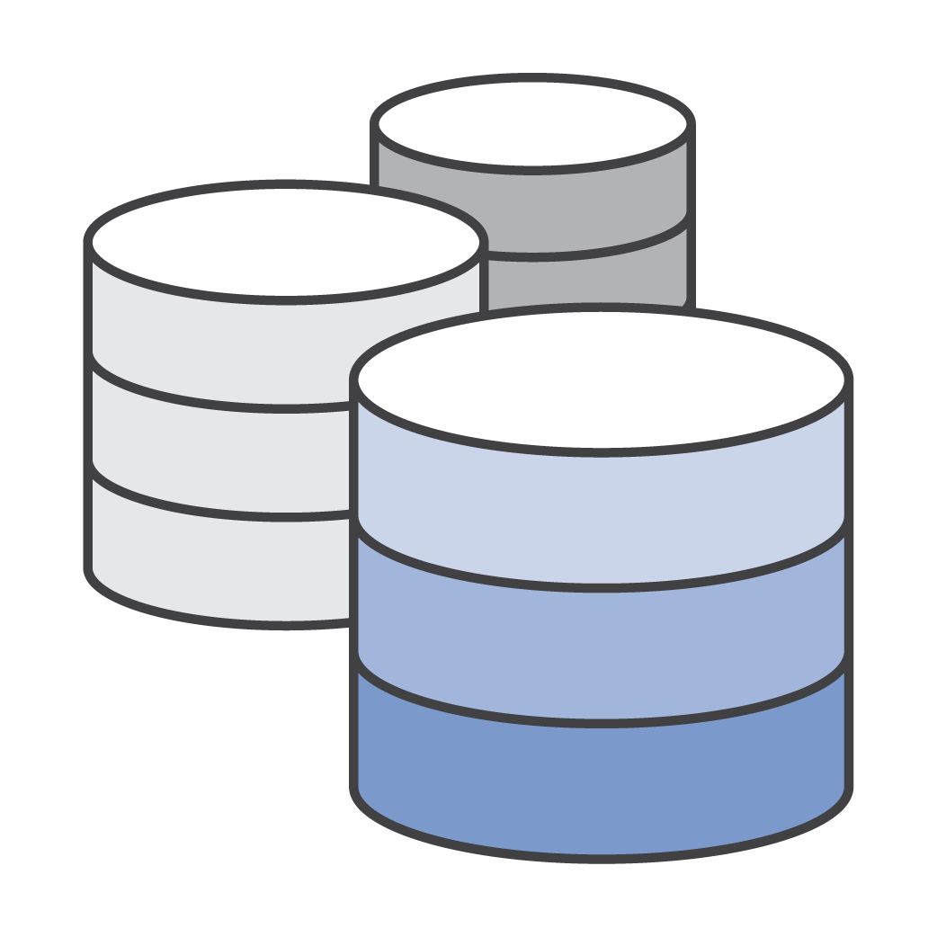




Serverless application
EVENT SOURCE
FUNCTION
SERVICES (ANYTHING)
Changes in data state
Node.js
Python
Java
C#
Requests to endpoints
Changes in resource state

Slide 5
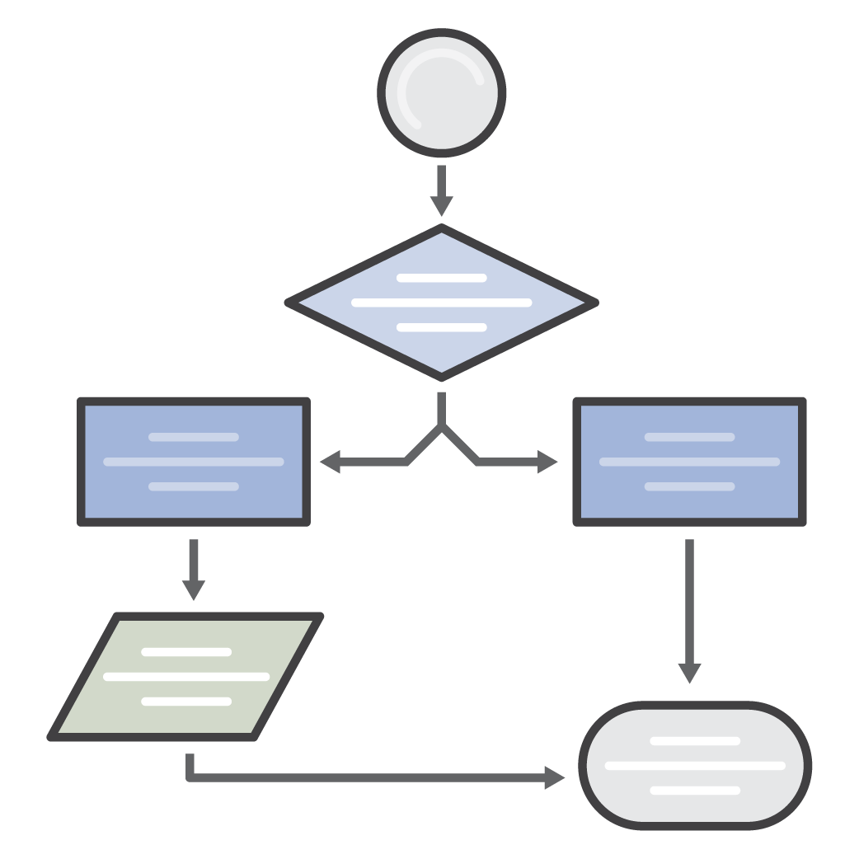
Common Lambda use cases
</>
</>
Web Applications
Static websites
Complex web apps
Packages for Flask and Express
Backends
Apps & services
Mobile
IoT
Data Processing
Real time
MapReduce
Batch
Chatbots
Powering chatbot logic
Amazon Alexa
Powering voice-enabled apps
Alexa Skills Kit
IT Automation
Policy engines
Extending AWS services
Infrastructure management

Slide 6












Event sources that trigger AWS Lambda
DATA STORES
ENDPOINTS
Amazon S3
Amazon DynamoDB
Amazon Kinesis
Amazon Cognito
Amazon API Gateway
AWS IoT
AWS Step Functions
Amazon Alexa
DEVELOPMENT AND MANAGEMENT TOOLS
EVENT/MESSAGE SERVICES
AWS CloudFormation
AWS CloudTrail
AWS CodeCommit
Amazon CloudWatch
Amazon SES
Amazon SNS
Cron events
… and more!

Slide 7

Meet SAM!

Slide 8
AWS Serverless Application Model (SAM)
CloudFormation extension optimized for serverless
New serverless resource types: functions, APIs, and tables
Supports anything CloudFormation supports
Open specification (Apache 2.0)
https://github.com/awslabs/serverless-application-model

Slide 9
AWS Serverless Application Model (SAM)
CloudFormation extension optimized for serverless
New serverless resource types: functions, APIs, and tables
Supports anything CloudFormation supports
Open specification (Apache 2.0)
https://github.com/awslabs/serverless-application-model

Slide 10
AWS CloudFormation
Create templates of your infrastructure
CloudFormation provisions AWS resources based on dependency needs
Version control/replicate/update templates like code
Integrates with development, CI/CD, management tools
JSON and YAML supported

Slide 11
CloudFormation template
AWSTemplateFormatVersion: '2010-09-09'
Resources:
GetHtmlFunctionGetHtmlPermissionProd:
Type: AWS::Lambda::Permission
Properties:
Action: lambda:invokeFunction
Principal: apigateway.amazonaws.com
FunctionName:
Ref: GetHtmlFunction
SourceArn:
Fn::Sub: arn:aws:execute-api:${AWS::Region}:${AWS::AccountId}:${ServerlessRestApi}/Prod/ANY/*
ServerlessRestApiProdStage:
Type: AWS::ApiGateway::Stage
Properties:
DeploymentId:
Ref: ServerlessRestApiDeployment
RestApiId:
Ref: ServerlessRestApi
StageName: Prod
ListTable:
Type: AWS::DynamoDB::Table
Properties:
ProvisionedThroughput:
WriteCapacityUnits: 5
ReadCapacityUnits: 5
AttributeDefinitions:
- AttributeName: id
AttributeType: S
KeySchema:
- KeyType: HASH
AttributeName: id
GetHtmlFunction:
Type: AWS::Lambda::Function
Properties:
Handler: index.gethtml
Code:
S3Bucket: flourish-demo-bucket
S3Key: todo_list.zip
Role:
Fn::GetAtt:
- GetHtmlFunctionRole
- Arn
Runtime: nodejs4.3
GetHtmlFunctionRole:
Type: AWS::IAM::Role
Properties:
ManagedPolicyArns:
- arn:aws:iam::aws:policy/AmazonDynamoDBReadOnlyAccess
- arn:aws:iam::aws:policy/service-role/AWSLambdaBasicExecutionRole
AssumeRolePolicyDocument:
Version: '2012-10-17'
Statement:
- Action:
- sts:AssumeRole
Effect: Allow
Principal:
Service:
- lambda.amazonaws.com
ServerlessRestApiDeployment:
Type: AWS::ApiGateway::Deployment
Properties:
RestApiId:
Ref: ServerlessRestApi
Description: 'RestApi deployment id: 127e3fb91142ab1ddc5f5446adb094442581a90d'
StageName: Stage
GetHtmlFunctionGetHtmlPermissionTest:
Type: AWS::Lambda::Permission
Properties:
Action: lambda:invokeFunction
Principal: apigateway.amazonaws.com
FunctionName:
Ref: GetHtmlFunction
SourceArn:
Fn::Sub: arn:aws:execute-api:${AWS::Region}:${AWS::AccountId}:${ServerlessRestApi}/*/ANY/*
ServerlessRestApi:
Type: AWS::ApiGateway::RestApi
Properties:
Body:
info:
version: '1.0'
title:
Ref: AWS::StackName
paths:
"/{proxy+}":
x-amazon-apigateway-any-method:
x-amazon-apigateway-integration:
httpMethod: ANY
type: aws_proxy
uri:
Fn::Sub: arn:aws:apigateway:${AWS::Region}:lambda:path/2015-03-31/functions/${GetHtmlFunction.Arn}/invocations
responses: {}
swagger: '2.0'

Slide 12
CloudFormation template
AWSTemplateFormatVersion: '2010-09-09'
Resources:
GetHtmlFunctionGetHtmlPermissionProd:
Type: AWS::Lambda::Permission
Properties:
Action: lambda:invokeFunction
Principal: apigateway.amazonaws.com
FunctionName:
Ref: GetHtmlFunction
SourceArn:
Fn::Sub: arn:aws:execute-api:${AWS::Region}:${AWS::AccountId}:${ServerlessRestApi}/Prod/ANY/*
ServerlessRestApiProdStage:
Type: AWS::ApiGateway::Stage
Properties:
DeploymentId:
Ref: ServerlessRestApiDeployment
RestApiId:
Ref: ServerlessRestApi
StageName: Prod
ListTable:
Type: AWS::DynamoDB::Table
Properties:
ProvisionedThroughput:
WriteCapacityUnits: 5
ReadCapacityUnits: 5
AttributeDefinitions:
- AttributeName: id
AttributeType: S
KeySchema:
- KeyType: HASH
AttributeName: id
GetHtmlFunction:
Type: AWS::Lambda::Function
Properties:
Handler: index.gethtml
Code:
S3Bucket: flourish-demo-bucket
S3Key: todo_list.zip
Role:
Fn::GetAtt:
- GetHtmlFunctionRole
- Arn
Runtime: nodejs4.3
GetHtmlFunctionRole:
Type: AWS::IAM::Role
Properties:
ManagedPolicyArns:
- arn:aws:iam::aws:policy/AmazonDynamoDBReadOnlyAccess
- arn:aws:iam::aws:policy/service-role/AWSLambdaBasicExecutionRole
AssumeRolePolicyDocument:
Version: '2012-10-17'
Statement:
- Action:
- sts:AssumeRole
Effect: Allow
Principal:
Service:
- lambda.amazonaws.com
ServerlessRestApiDeployment:
Type: AWS::ApiGateway::Deployment
Properties:
RestApiId:
Ref: ServerlessRestApi
Description: 'RestApi deployment id: 127e3fb91142ab1ddc5f5446adb094442581a90d'
StageName: Stage
GetHtmlFunctionGetHtmlPermissionTest:
Type: AWS::Lambda::Permission
Properties:
Action: lambda:invokeFunction
Principal: apigateway.amazonaws.com
FunctionName:
Ref: GetHtmlFunction
SourceArn:
Fn::Sub: arn:aws:execute-api:${AWS::Region}:${AWS::AccountId}:${ServerlessRestApi}/*/ANY/*
ServerlessRestApi:
Type: AWS::ApiGateway::RestApi
Properties:
Body:
info:
version: '1.0'
title:
Ref: AWS::StackName
paths:
"/{proxy+}":
x-amazon-apigateway-any-method:
x-amazon-apigateway-integration:
httpMethod: ANY
type: aws_proxy
uri:
Fn::Sub: arn:aws:apigateway:${AWS::Region}:lambda:path/2015-03-31/functions/${GetHtmlFunction.Arn}/invocations
responses: {}
swagger: '2.0'

Slide 13
SAM template
AWSTemplateFormatVersion: '2010-09-09’
Transform: AWS::Serverless-2016-10-31
Resources:
GetHtmlFunction:
Type: AWS::Serverless::Function
Properties:
CodeUri: s3://sam-demo-bucket/todo_list.zip
Handler: index.gethtml
Runtime: nodejs4.3
Policies: AmazonDynamoDBReadOnlyAccess
Events:
GetHtml:
Type: Api
Properties:
Path: /{proxy+}
Method: ANY
ListTable:
Type: AWS::Serverless::SimpleTable

Slide 14
SAM template
AWSTemplateFormatVersion: '2010-09-09’
Transform: AWS::Serverless-2016-10-31
Resources:
GetHtmlFunction:
Type: AWS::Serverless::Function
Properties:
CodeUri: s3://sam-demo-bucket/todo_list.zip
Handler: index.gethtml
Runtime: nodejs4.3
Policies: AmazonDynamoDBReadOnlyAccess
Events:
GetHtml:
Type: Api
Properties:
Path: /{proxy+}
Method: ANY
ListTable:
Type: AWS::Serverless::SimpleTable
Tells CloudFormation this is a SAM template it needs to “transform”
Creates a Lambda function with the referenced managed IAM policy, runtime, code at the referenced zip location, and handler as defined. Also creates an API Gateway and takes care of all mapping/permissions necessary
Creates a DynamoDB table with 5 Read & Write units

